Slide 1
Metagenomics and Ancient DNA
Emrah Kırdök, PhD

Slide 2
Overview
Metagenomics:
The idea
Methods on Ancient metagenomics research
Ancient Diseases:
How metagenomics helps us to understand ancient diseases?
Notes:
I would like to present my lecture in two parts. In first part I would like to explain the building blocks of metagenomic method, and how we use this foundation to understand historical specimens.
In the second part, I would like to give information about the diseases and the latest studies on ancient diseases.

Slide 3
Metagenomics
The aim is to understand:
Who are they?
What are they doing?
How they interact with each other?
Notes:
Metagenomics consists of a series of methods that helps us to understand microbial diversity in a particular niche. Traditional microbiological methods allows us to understand to a point.
However, less then 5% of the micro organisms are culturable using the traditional microbiology methods. That means we could not access a big part of the microbial diversity.
Metagenomics helps us to access the microbial species that we can not culturable using traditional microbiology methods and identify them through DNA sequence traces.
The aim of the metagenomics are could be summarised down to three points:
Who are they?
In metagenomics we would like to understand the microbial composition of the ecological niche of interest.
This step is also called as taxonomical classification
What are they doing?
Functional classification
How they interact with each other?
We could compare different ecological niches and how they interact.
Think about human microbiome. Every body part has its own niche but they are somewhat connected.

Slide 5
Notes:
In metagenomics we focus on not one sample but a group of samples. We could describe it as a bowl of candies. The centre bowl that contains different colours - which we call species.
On this case we call the bowl as ecological niche.
This niche could be anything, soil, lake, or even human body. In human body we have also different niches and every body part has its own microbial diversity.
The main idea of metagenomics is to understand the microbial composition of the niche.

Slide 7
The PCA visualisation of Human Microbiome Project Samples. PC 1 and PC 2 components are shown
Notes:
After we classify each sequence, we could calculate the taxonomical composition in the particular niche. That will allow us to compare different niches of interest. For example, human body consists of different ecological parts. This plot shows the visualised ecological distances of different body parts. Every dot represents a body part.
Red dots are gut microbiome samples.
Green dots oral microbiome samples
Purple is urogenital tract
Blue dots are skin samples
Every body part has its own microbiome composition.

Slide 8
Metagenomics
Notes:
Let’s not dive in directly metagenomics. Let’s remember how we do things in classical genomics first. In genomics we study the changes in genomic composition in a specific target of interest organism.
For example, evolutionary history of one particular specimen will be subjected to population genomics analysis. In here we are working with one reference genome at a time.

Slide 9
Changes in genetic composition
Sample
A
DNA
T
G
Mapping
C
SNP/Variant

Slide 10
Metagenomics
Notes:
Let’s not dive in directly metagenomics. Let’s remember how we do things in classical genomics first. In genomics we study the changes in genomic composition in a specific target of interest organism.
For example, evolutionary history of one particular specimen will be subjected to population genomics analysis. In here we are working with one reference genome at a time.

Slide 11
reference genome
100%
85%
71%

Slide 12
reference genome 1
reference genome 2
85%
85%
100%
Notes:
Competitive mapping. Similar and repetitive regions could cause misalignments. So, all the DNA reads that have close sequence homology could map to the one part of the genome.
We do not want this to happed. So we include as much reference genome as possible to resolve closely related regions and repetitive regions.

Slide 13
Family
Reference genome 3
98%
Reference genome 1
95%
Reference genome 2
Reference genome 4
93%
Genus
Phylum
Species
Root
Root - Domain – Phylum - …. – Family - Genus - Species
Notes:
We have demonstrated competitive mapping. But we should include taxonomy information, otherwise we could not place the reads on a taxonomical node.
Taxonomy is a tree like hierarchical structure. The base node is named as root. All the lineages diverge from that point.
Taxonomy information is needed to curate reference genome databases, and place DNA sequences on higher taxonomical nodes if needed.
Which taxonomic clade are the reads fall? We align our DNA sequences to reference genomes. These genomes have taxonomy information that defines their place in the taxonomy tree. If we could map a DNA sequence to only one reference genome with a high similarity, that means we find a taxonomy lineage for this sequence.
What if we map aDNA sequence to more then one reference genome? Then we need to analyse the alignments on a taxonomy tree. So, it is possible to place a DNA sequence anywhere in the taxonomical tree.

Slide 14
Species A
7
Species B
6
Notes:
At the end, we end up a table showing the taxonomy nodes and the DNA read counts that are associated with those nodes.
Then we could continue with absolute abundances or we transform absolute abundances to relative abundance (that shows the proportion).

Slide 15
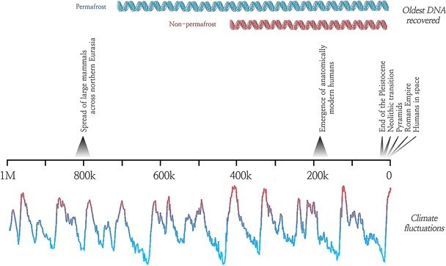
Ancient Metagenomics
The timescale of ancient DNA studies (Hofreiter et al., 2014)
Notes:
So, if we come to ancient metagenomics, now we are working with a material that could be up to thousands of years old. Theoretically DNA could survive up to one million years.
The oldest ancient genome recovered is 700 thousand years old.
Ancient metagenomics could help us to
Observe ancestral state of our microbiome
Study microbiome evolution
Understand how pathogens evolved

Slide 17
< %1 maps to host genome
(but really depends on the conservation status)
%20 - %34 identified
Composition of an aDNA library
Host microbiome
Environmental microbiome
%65 - %79 remains unaligned
Notes:
How we could access to this microbial diversity? If we take an ancient sample and sequence it.
Just a small portion of this material belongs to host DNA. But that depends on the preservation status of the sample. This figure (1%) shows one of my latest study.
Rest of the DNA sequences either comes from the host microbiome or the microbiome that surrounds the historical material.
Still, we could not characterise the rest. And this is a problem.

Slide 18
5’ END
3’ END
C –> T
G –> A
Deamination patterns observed in aDNA sequences
Notes:
Another important aspect is DNA damage. DNA sequences often show nucleotide lesions. And those lesions often interferes mapping process.
So, relaxed alignment parameters should be selected in order to align aDNA fragments and that strategy allow more false positives. However, DNA damage also is used to as a marker to authenticate ancient DNA sequences.

Slide 19
Ancient Metagenomics
Not all species exists in our databases
Database bias to well studies microorganisms
Notes:
Another problem is the database bias. Our reference genomes database are biased to well known and well studied microbial species.
We have enough information to classify species. But there is also an intraspecific diversity which contains significant variation between strain of the same species. We don’t have most of the species that are existed in ancient times. So we limited with our current knowledge.

Slide 20
Ancient Metagenomics
How metagenomic methods helps us to understand ancient microbiome?

Slide 21
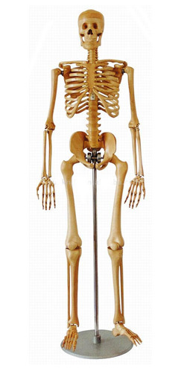
Sampling
Ancient calculus
Teeth
Masticates
Gut microbiome in mummified tissues
Long bones
(specific lesions)
Notes:
What is the metagenomic method in ancient metagenomics?
We start with a sample. Let’s focus on ancient human metagenomics for now. For a typical demography study, we use petrous bones, teeth pulp material. Also we could use preserved bone material as well.
However those materials could encapsulate low amounts of human microbiome species.
Ancient calculus, conceived wet tissues (like Tyrolean iceman gut) could be used as well to study human ancient microbiome. Those samples helps us to view the metagenome of ancient individuals.
Teeth pulp could conserve blood borne pathogens. And it is shown that they have a greater microbial diversity then petrous bones.
Even long bones could conserve pathogens if they have visible lesions.

Slide 22
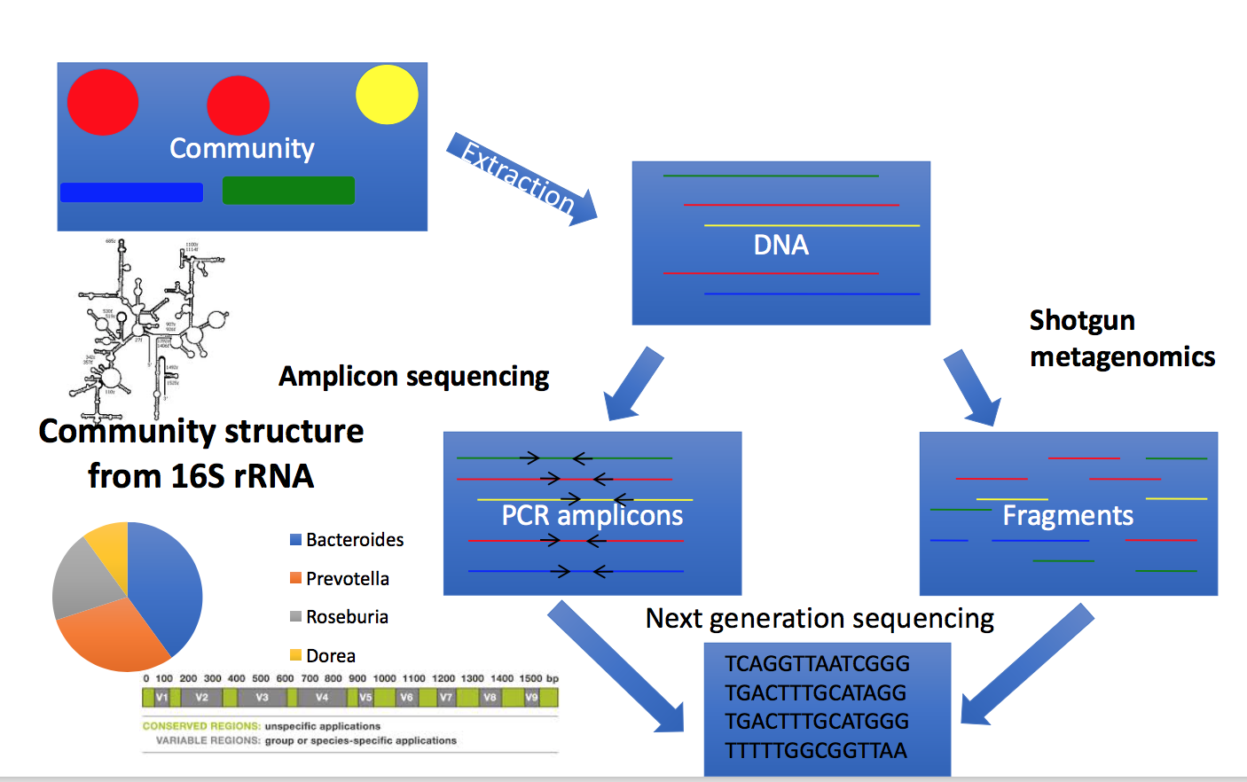
Notes:
The ancient metagenomic process starts with a usual ancient demography analysis. We extract DNA sequences from historical specimens and select the sequencing strategy.
In amplicon sequencing, we amplify marker sequences that distinguish between species. For bacteria, that marker sequence is generally 16S rDNA sequence. Using universal primers that targets this sequences, we amplify DNA sequences and then use next generation sequencing technology. After sequencing, we align marker sequences back to their references. Then we count the aligned sequences. Since we know the copy number of each gene, we could normalise the counted value and find the abundance of each microbe.
In shotgun sequencing, we randomly amplify what we have found in the historical sample. We do not seek for any particular markers. In modern metagenomic studies, generally we chemically or physically break DNA strand to form smaller fragments. However in ancient DNA studies we do not to do this since we have already fragmented DNA.Then we align our sequences to the reference genome database.
There are other strategies as well. If we could create a capture panel, we could easily enrich microbial DNA or a specific pathogenic genome.

Slide 23
Databases
RefSeq
HOMD
Human oral microbiome database
HMP
Human microbiome database
Notes:
We call the set of reference genomes as database. Reference genomes are the starting point .
NCBI RefSeq is a manually curated reference and representative genome database. https://www.ncbi.nlm.nih.gov/refseq/
Human Oral Microbiome Database is an attempt to catalogue bacterial species in oral parts of our bodies. http://www.homd.org
Human Microbiome Database contains DNA sequencing studies from different parts of our microbiome. https://hmpdacc.org

Slide 24
Tools in metagenomics
Taxonomical profiling
Taxonomical classification

Slide 25
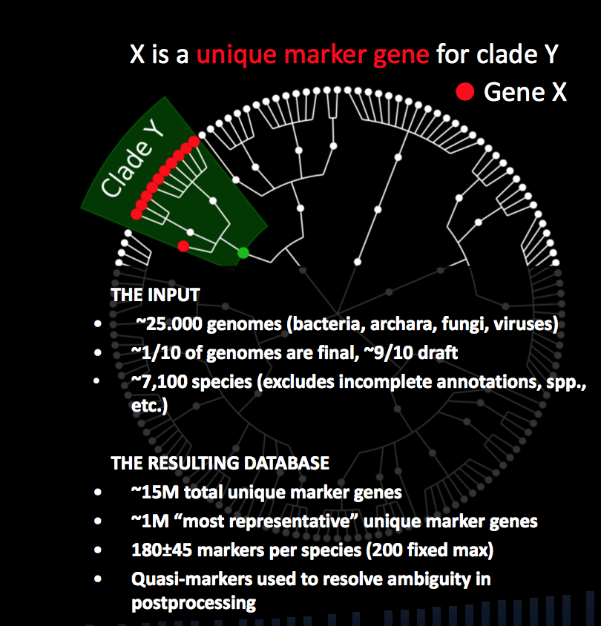
Metaphlan2
A set of marker database:
Clade specific marker database
15 million markers
180 markers for each species
Can not use all the sequences
Notes:
Metaphlan2 is one of the popular and fast taxonomic profiling tool out there. The idea of this tool is to use a marker reference database that is curated from 1 million species.
The marker sequences are clade specific so every marker represents one species or strains. However, we could not align all the sequences that we have so that is why it is called profiler.
The advantage is that it is fast and produces comparable results between studies.

Slide 26
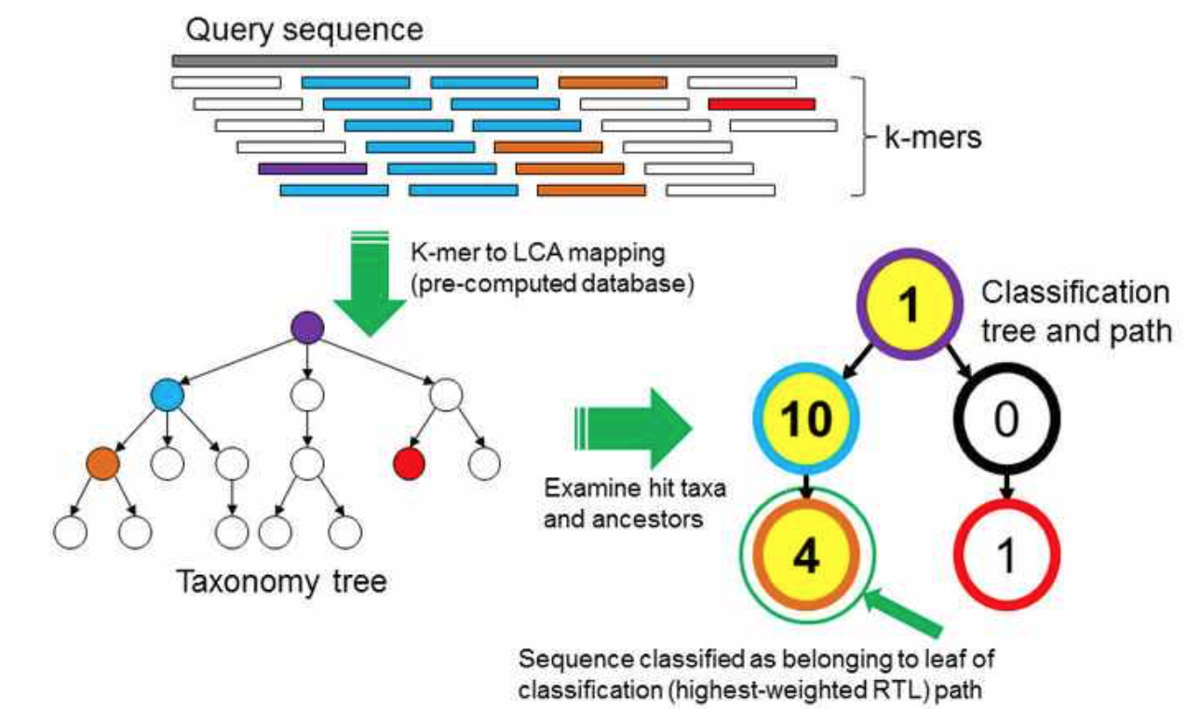
Kraken2
Uses k-mer profiles instead of aligning
Very fast and sensitive but precision is low.
Notes:
Kmer is a k-length of DNA fragment.
The idea in here is to create a model for each taxonomic node based on the k-mer composition observed in samples.
Sensitivity is high, but precision is low.
It is documented that k-mers up to 31 nucleotides long could be discriminative for subspecies level.

Slide 27
Taxonomical Classification
Y. pseudotuberculosis
94%
98%
Y. pestis
98%
95%
Y. pestis
96%
98%
Y. pestis
99%
99%
Family
Species
Genus
Root
Yersinia pestis
Yersinia
Notes:
Lowest common ancestor method.
The current paradigm in LCA methodology is to label a DNA read with an appropriate taxonomical node.
Let’s think that we are doing our metagenomic search through homology. Tools often set a homology threshold to place a DNA read into a taxonomical node.
In SC1 lets think that our DNA reads matched into a specific species reference genome. Using a 97% similarity thresold, we could confidentially map the DNA read to a specific species taxonomy node. Since the read has aligned only the reference genomes belonged to this species.
However most of the time that is not the case. DNA reads often aligns more then one species reference genomes with a high homology. In SC2, we end up with two species in the same genus.
In this case, LCA of this read is the genus taxonomy node.

Slide 28
What is the result?
Species | Absoute Abundance | Relative Abundance
Species A | 23 | 0.12
Species B | 45 | 0.24
Species C | 76 | 0.4
Species D | 45 | 0.23
Notes:
After those steps what we get is a number of DNA reads that are assign to a specific taxonomy node. This number is called as absolute abundances.
If we normalise those values with the sequencing depth (the total number of taxonomically identified sequences or the total number of sequences in a DNA library) we got the relative abundance value that shows the proportion of the taxonomical nodes.
These values serves the main input for the downstream analyses.

Slide 29
Diversity analysis
Alpha diversity
Number of species observed in a particular niche
Beta diversity
Bray-Curtis distance
Notes:
Metagenomics allow us to study the taxonomical composition in two ways:
Species diversity (alpha diversity): This defines the number of species observed in a niche.
Beta diversity: This defines the difference between two niche. Beta diversity value shows the dissimilarity of two niche. Bray-Curtis distance is often used to calculate ecological distances between niches.

